Slide 1
Bradley Stoke Way Multimodal Corridor
Ward Member & Town Council update – 30th September

Slide 2
Briefing agenda
Overall summary
Upcoming Traffic Management impact – early October – mid-December
Pedestrian diversion route
Future programme of works – summary
Feedback & Questions

Slide 3
Summary status
Overall project is progressing to programme
Two phases substantially completed with some snagging and remedials along with landscaping due to take place in future.
Great Stoke Roundabout – approaching Baileys Court Roundabout
Baileys Court Roundabout – Webbs Wood Roundabout.
Ongoing works at Baileys Court & Webbs Wood Roundabouts along with length between Webbs Wood – Savages Wood Roundabout.
Overall through the duration of project till Winter 2026 there will be 3 phases of work ongoing with 4 phases in early 2026.
Overall we recognise the traffic impact however appears to be general acceptance to the scheme. Aim to provide greater awareness of construction progress.

Slide 4
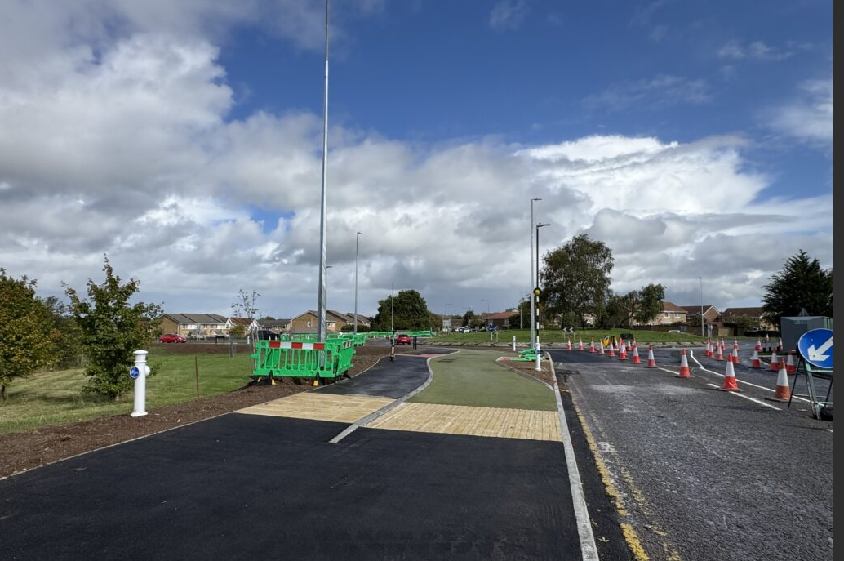
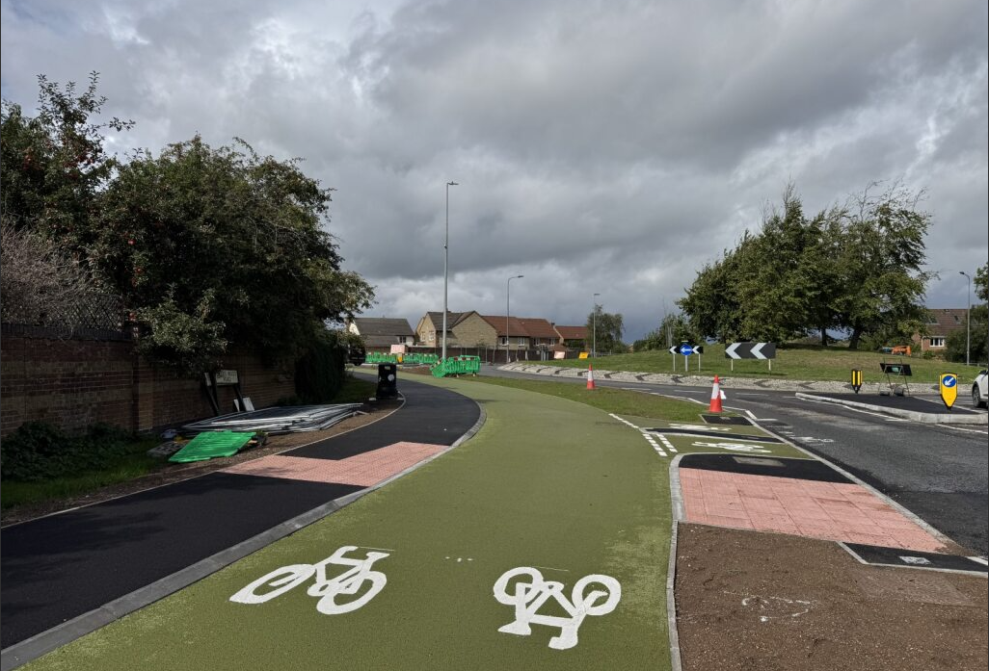
Baileys Court & Webbs Wood roundabouts progress

Slide 5
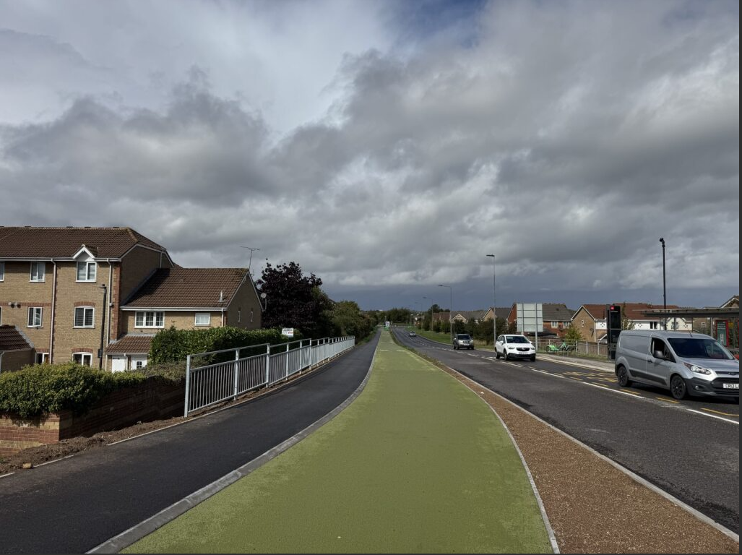
Baileys Court – Webbs Wood roundabout: Completed

Slide 6
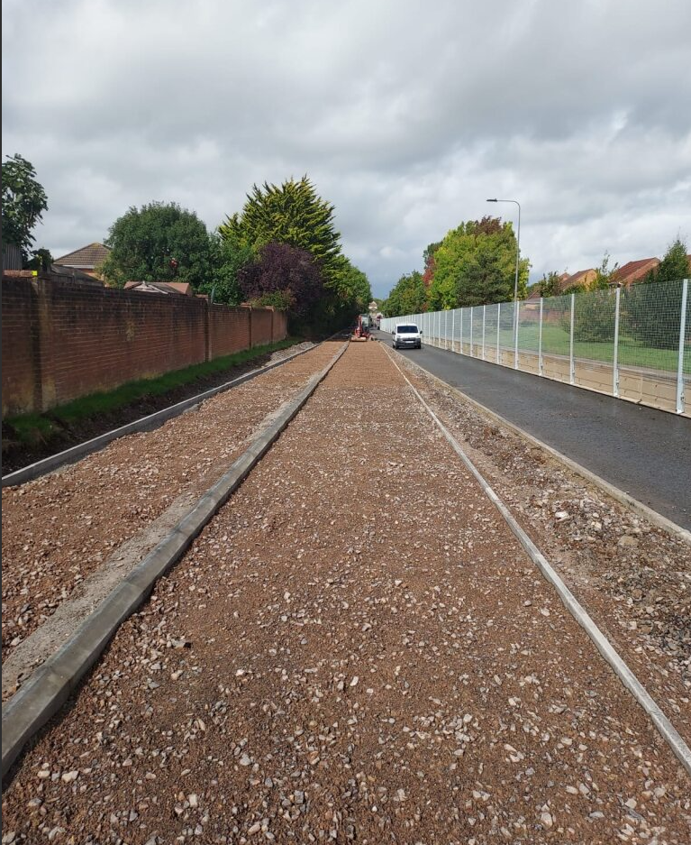
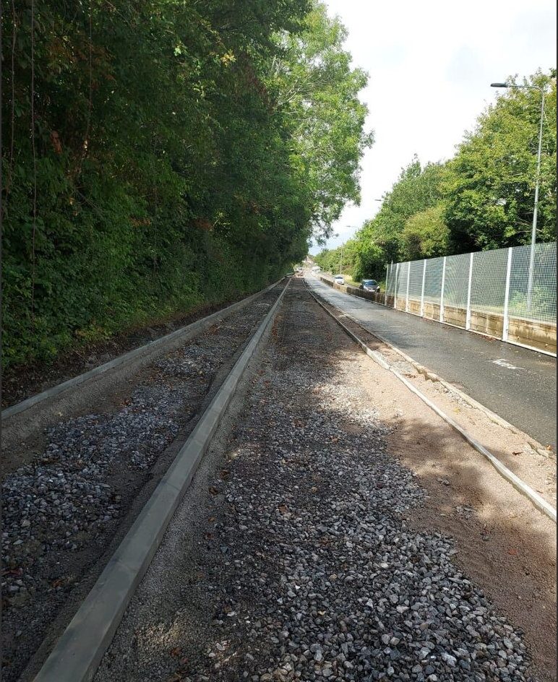
Webbs Wood – Savages Wood roundabout progress

Slide 7
Upcoming Traffic Management

Slide 8
Traffic Management - October
Dates | Works | Impact
6 – 19 October | Temporary traffic lights, moving along Bradley Stoke Way in phases (8pm to 6am), between Savages Wood Roundabout and Great Meadow Roundabout. | Possible delays for road users.
20 October – 2 November | Overnight closures (8pm to 6am) along the length of Bradley Stoke Way, between Savages Wood Roundabout and Baileys Court Road. | Diversion routes in place overnight. No impact on road users during daytime hours.

Slide 9
Traffic Management – November - December
Dates | Works | Impact
3 – 16 November | Overnight resurfacing (8pm to 6am) of Bradley Stoke Way, between Savages Wood Roundabout and Webbs Wood Roundabout. | Full overnight road closure with no access to vehicles (road open as normal during the day). Diversion routes will be in place. Work will include weekends, with significant noise and vibrations expected.
17 – 30 November | Overnight resurfacing (8pm to 6am) on Webbs Wood Roundabout. | Full overnight road closure with no access to vehicles (road open as normal during the day). Diversion routes will be in place. Work will include weekends, with significant noise and vibrations expected.
1 – 14 December | Overnight resurfacing (8pm to 6am) on Great Meadow Roundabout. | Full overnight road closure with no access to vehicles (road open as normal during the day). Diversion routes will be in place. Work will include weekends, with significant noise and vibrations expected.

Slide 10
Future programme of works

Slide 11
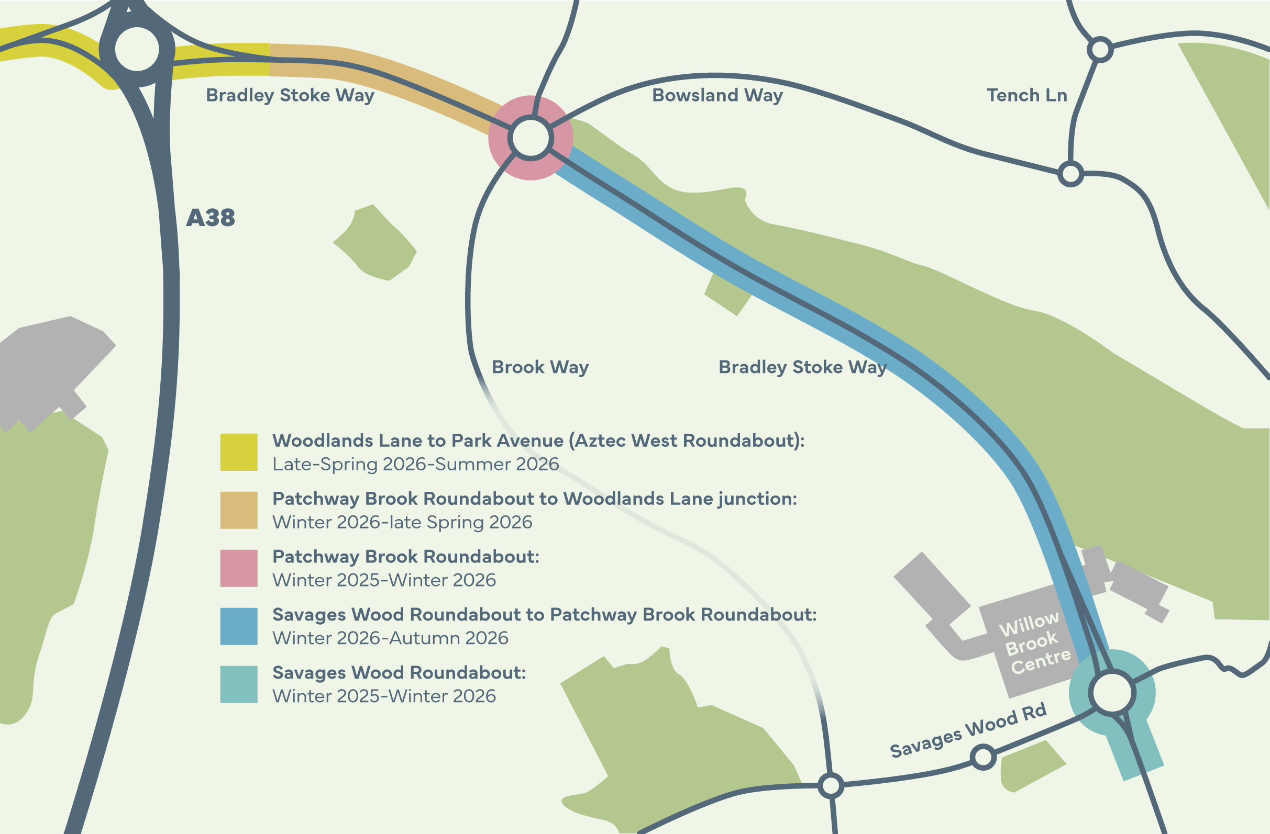
Future programme of works - summary

Slide 12
Future programme of works - phases
Phase & location | Start | Completion
Savages Wood Roundabout | Winter 2025/26 (January 2026) | Winter 2026
Patchway Brook Roundabout | Winter 2025/26 (January 2026) | Winter 2026
Savages Wood – Patchway Brook Roundabout | Winter 2025/26 (January 2026) | Autumn 2026
Patchway Brook Roundabout – Woodlands Lane | Winter 2025/26 (January 2026) | Spring 2026
Woodlands Lane – Park Avenue | Spring 2026 | Summer 2026

Slide 13
Feedback & Questions

Slide 14
Tom Lacey, Principal Project Manager

